Slide 1
Regression Project – PTDS 2403
David Harrison (November 2024)

Slide 2
Overview
The data provided for the project represents emissions from the agri-food sector for the period 1990 to 2020, across 236 areas.
The data includes 23 sources of carbon dioxide emissions across these areas and the period above.
A population split between urban and rural and male and female is also provided.
The purpose of the project is to predict the annual change in temperate given specific data inputs.
We will attempt to review the various sources of emissions and population levels to understand what drives the change in temperature.
On closer inspection of the data we found that the figures for China have been duplicated into sub areas. Therefore we have removed the figures for: China (Hong Kong), China (Macau), China (mainland), and China (Taiwan); leaving the total represented by the entries for China

Slide 3
Initial Analysis of the Data
To understand the problem better and the contributing factors

Slide 4
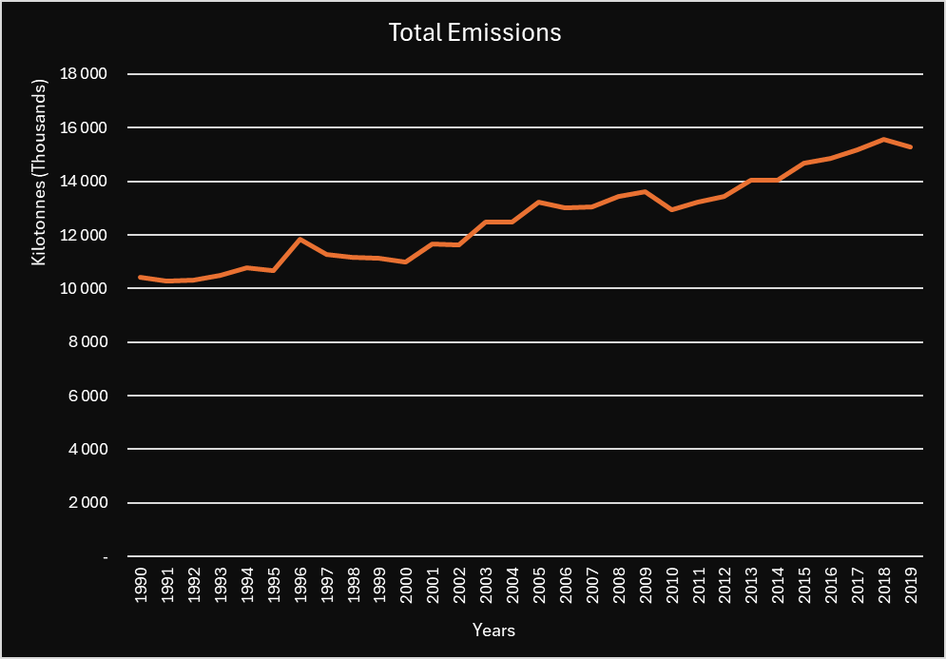
Total Emissions Trend
Total emissions have been steadily growing since 1990, (10.3m kilo tonnes), through to 2020, (15.3m kilo tonnes).
This is a growth of 49% over the period or a compounded annual growth rate of 1.3% each year

Slide 5
Total Emissions

Slide 6
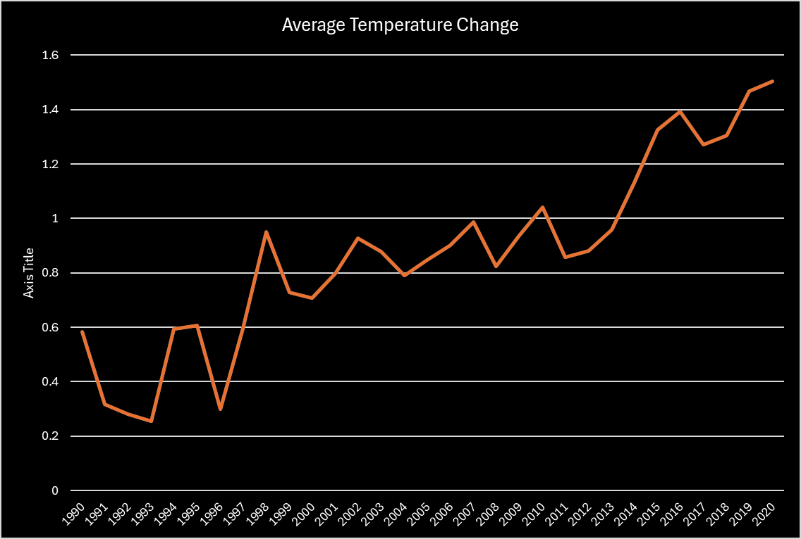
Average Temperate Change
Average annual temperate change over time follows the same trend as total emissions over time, both showing a similar trend.
1990 – 1997: yearly average temperature change was 0.44 degrees Celsius
1998 – 2013: yearly average temperature change was 0.88 degrees Celsius
2014 – 2020: yearly average temperature change was 1.34 degrees Celsius

Slide 7
Average Temperate Change
We averaged the change in temp over the period for each area and ranked areas in descending order f averarage temperate change
Interesting to note that the majority of the top 20 areas are in Europe

Slide 8
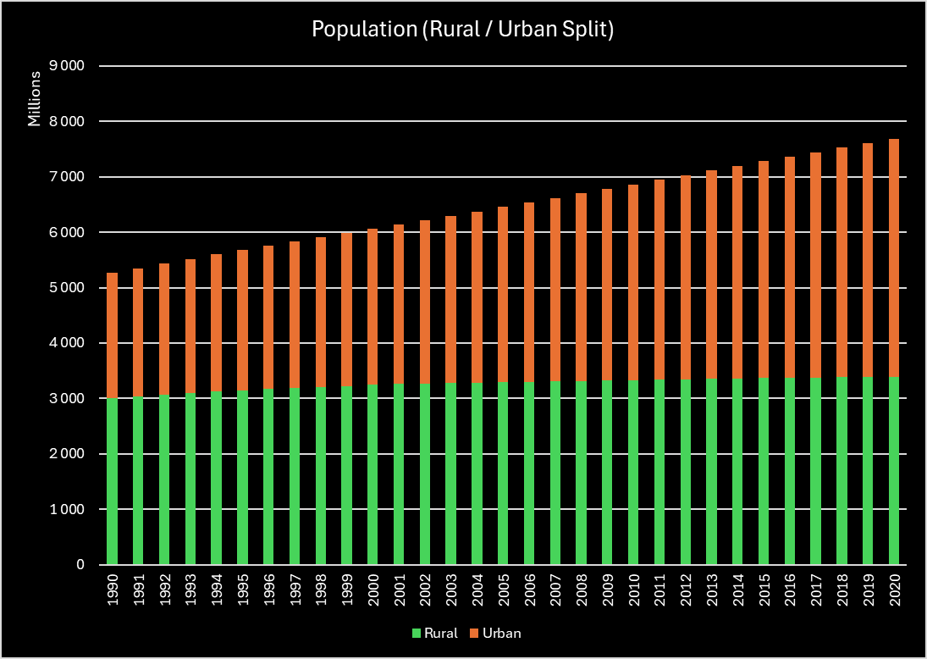
Population Split
Total population across the areas has grown from 5.3 billion to 7.7 billion, ( a 46% growth over the period)
This is a compound annual growth rate of 1.3%
The percentage of people living in urban areas has grown from 43% in 1990, to 56% in 2020
Interestingly these growth rates are very similar to total emissions in the sector. As the population grows, so does the need for food production.

Slide 9
Total Population 2020

Slide 10
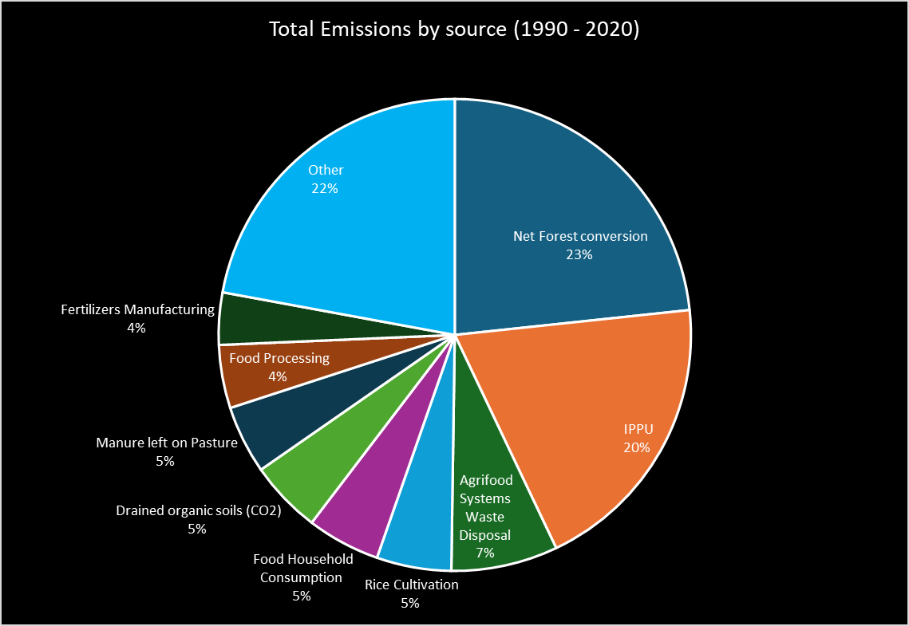
Emission Sources
The graph represents sources that add to CO2 emissions, therefore excludes Forestland
Net forest conversion, IPPU (), and Agrifood Systems Waste Disposal accounts for 50% of the CO2 emissions

Slide 11
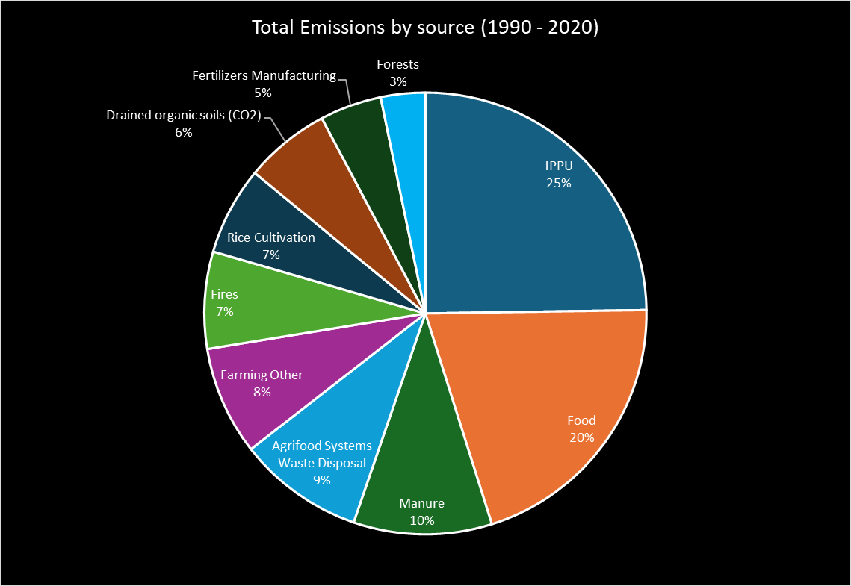
Emission Sources (Summarised)
We grouped the emission sources into logical groups.
On doing this Forests nets off to 3% of total CO2 emissions, because of Forestland providing a net off effect
IPPU, Food and Manure contribute to 55% of total CO2 emissions.
It would be interesting to see if the grouped features contributes to better predictions
Food includes:
Manure includes:
Farming Other includes:
Fires includes:

Slide 12
Exploratory Data Analysis

Slide 13
Regression Models Applied

Slide 14
Multiple Regression

Slide 15
Lasso

Slide 16
Decision Trees

Slide 17
Random Forests

Slide 18
Comparisons of the Models

Slide 19
Most Appropriate Model to Use

